Slide 1
Model-Based for Traceability and Prioritization of Defects
Case Study

Slide 2
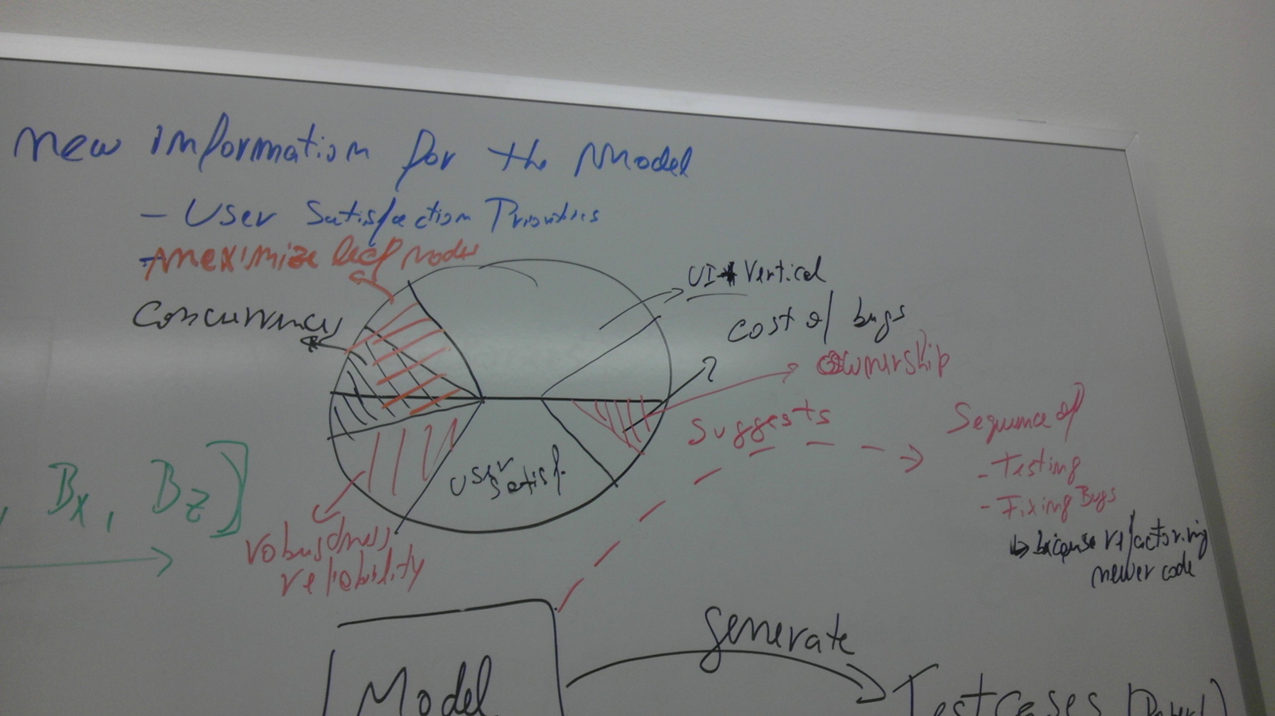
Distribution of Issues in Test and Bug Sequencing

Slide 3
Inspiration through counterpointing
Bug Assignment based on Expertise
“Not My Bug!” and Other Reasons for Software
Bug Report Reassignments, 2011
Who Should Fix This Bug?, 2006
Scenario-driven?
Scenario-driven Specification-based Testing
against Goals and Requirements, 2010
Model Privileges: Static and Assynchronous Aspects of Requirements Artifacts
What is the best Sequence for Testing and Fixing, Now?
MbSRT2: Model-based Selective Regression Testing with Traceability, 2010
Communication, Collaboration, and Bugs: The Social Nature of Issue Tracking in Small, Collocated Teams, 2010
A Visual Traceability Modeling Language, 2010
Model Privileges : Dynamic and Synchronous Aspects

Slide 4
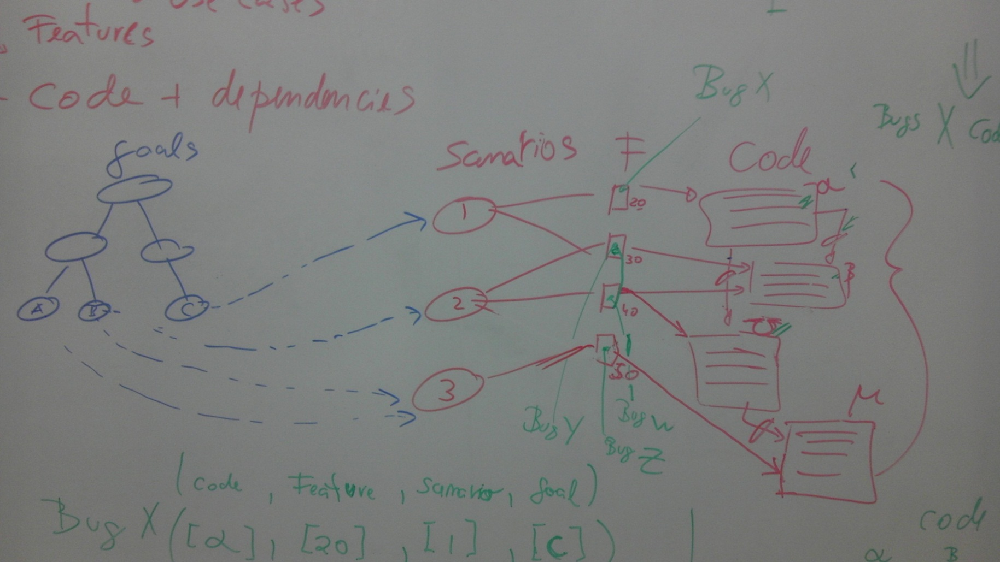
Graph of Dependencies

Slide 5
Summary Bug Traceability to Artifacts
Bugs | Code | Feature | Scenario | Goal
Bx | α | 20 | 1 | C
By | β | 30 | 1, 2 | B
Bw | β, Ω | 40 | 2 | B
Bz | μ | 50 | 3 | A

Slide 6
Objective
Evolve a model during requirements engineering in order to influence decision making during the test phase, in regards to:
Test selection and execution
Bug prioritization and sequencing

Slide 7
Glossary
Goal: an objective a user wish to attain with the system
Scenario: description of actions, responsibilities and actors
Features: functionalities accessible by the user
Code: classes or methods
Bug: defect identified while executing a test case

Slide 8
Assumptions
Changes should happen in the model before they are effected in the code and documentation
Each bug is associated to a single feature
Features depend on each other based on shared code
Scenarios may be realized by more than one feature
Scenarios may share features
Goals may be realized by more than one scenario
Goals may share scenarios

Slide 9
Self-Dependency Matrices
Represent the relation among adjascent sets, for example, goals x features, features x code.

Slide 10
Dependency Matrix Goals x Re
Goals/Requirements | Req1 | Req2 | Req3
A | 0 | 0 | 1
B | 0 | 1 | 1
C | 1 | 0 | 0
Goal A depends on Feature 3
Goal B depends on Features 2 and 3
Goal C depends on Feature 1

Slide 11
Dependency Matrix Scenarios x Features
Scenarios/Features | 20 | 30 | 40 | 50
1 | 1 | 1 | 0 | 0
2 | 0 | 1 | 1 | 0
3 | 0 | 0 | 0 | 1

Slide 12
Dependency Matrix Features x Code
Requirement/ Code | α | β | Ʊ | μ
Req1 | 1 | 0 | 0 | 0
Req2 | 0 | 1 | 0 | 0
Req3 | 0 | 1 | 1 | 0
Req4 | 0 | 0 | 1 | 1

Slide 13
Dependency Matrix Features x Feature
Requirement/ Requirement | Req1 | Req2 | Req3 | Req4 | SUM
Req1 | 0 | 0 | 1 | 0 | 1
Req2 | 0 | 0 | 2 | 0 | 2
Req3 | 0 | 2 | 0 | 1 | 3
Req4 | 0 | 0 | 0 | 0 | 0

Slide 14
Dependency Matrix Code Dependency
Code/Code | α | β | Ω | μ | Afferent #
α | 0 | 1 | 1 | 0 | 2
β | 0 | 0 | 0 | 0 | 0
Ω | 0 | 0 | 0 | 1 | 1
μ | 0 | 0 | 0 | 0 | 0

Slide 15
Dependency Matrix Bugs x Features
Diagonal Matrix
Bugs/Requirments | Req1 | Req2 | Req3 | Req4
Bx | 1 | 0 | 0 | 0
By | 0 | 1 | 0 | 0
Bw | 0 | 0 | 1 | 0
Bz | 0 | 0 | 0 | 1

Slide 16
Dependency Matrix Bugs x Code
Bugs/Code | α | β | Ω | μ
Bx | 1 | 0 | 0 | 0
By | 0 | 1 | 0 | 0
Bw | 0 | 1 | 1 | 0
Bz | 0 | 0 | 0 | 1

Slide 17
Criteria for prioritizing bugs and test cases
Case Study of Possible Options

Slide 18
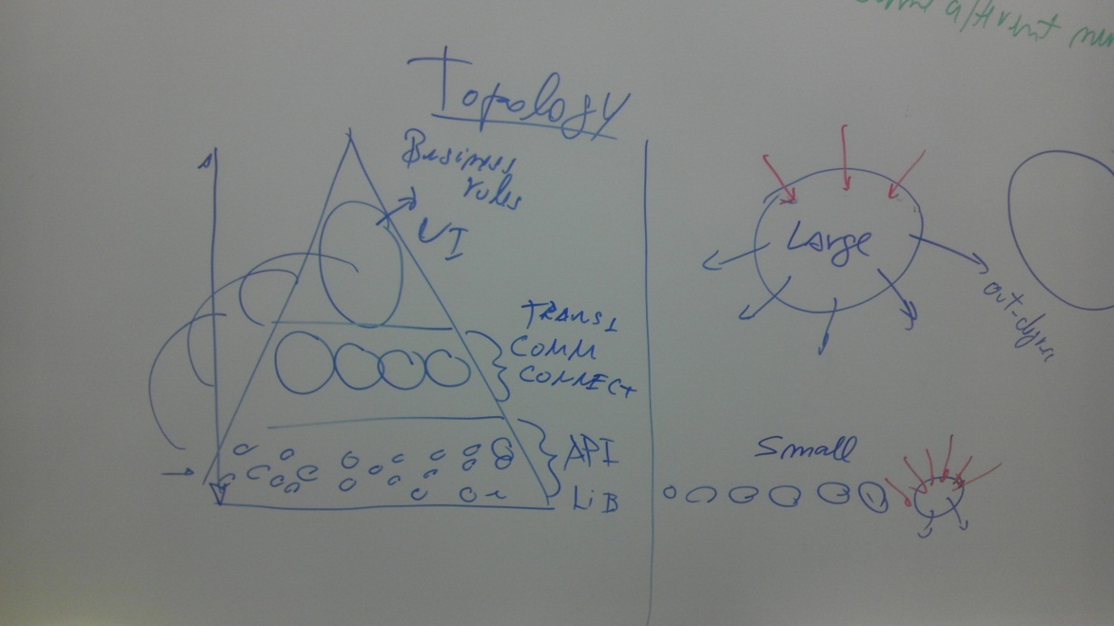
Traditional Approaches
Cost-based
Choose the most complex or simplest bugs to attack
Code ownership and programmer availability
“Not My Bug!” and Other Reasons for Software Bug Report Reassignments, 2011
Who Should Fix This Bug?, 2006
Maximize high in-degree artifacts
Feature and Code

Slide 19
Alternative Approaches
User Satisfaction Criteria
Goal priority: [A ,B ,C]
Therefore, looking at Traceability Summary Matrix, the bus priority would be: ([Bz], [Bw,By],[Bx])
Robustness and Reliability
Use Feature Dependency
Adding the features with more dependendants (high in-degree), we get the following priority: ([Bw], [By],[Bx],[Bz])
Minimize Concurrency
Use Code x Feature Dependency
Selecting for some code a vertical dependency (code based) while for others a horizontal dependency (feature based)
We get the following priority: ([Bx], [By,Bw],[Bz])

Slide 20
Summary of Sequences
Approach
1 Cost | Bx | By | Bw | Bz
2 Ownership | By | Bx | By | Bw
3 In-Degree | Bz | Bw | Bx | By
4 User Satisf | Bz | Bw | By | Bx
5 Robust/Reliab. | Bw | By | Bx | Bz
6 Concurrency | Bx | By | Bw | Bz

